Slide 1
Interactive Digital Portfolio
CAPSTONE PROJECT
Presented By:
1. Pallela Shanmkuha Srinadh – Kallam Haranadhareddy Institute Of Technology – Data Science

Slide 2
OUTLINE
Problem Statement (Should not include solution)
System Development Approach (Technology Used)
Algorithm & Deployment (Step by Step Procedure)
Result
Conclusion
Future Scope(Optional)
References

Slide 3
Problem Statement
Traditional resumes are static and lack visual appeal.
Developers struggle to showcase their skills in an engaging way.
Existing portfolios are often not interactive or personalized.
Lack of smooth navigation and animations make portfolios feel outdated.

Slide 4
System Approach
Frontend Technologies:
HTML5 – Provides the structure of the webpage, organizing content into meaningful sections (About Me, Skills, Projects, Contact).
CSS3 – Responsible for styling the webpage, ensuring visually appealing layouts, color schemes, and typography.
JavaScript – Adds dynamic interactivity to the site, such as smooth scrolling, hover effects, and animations. Also manages interactive elements like form validation.

Slide 5
Design Approach:
Clean and User-Friendly Interface: Focused on simplicity and ease of navigation to ensure an intuitive user experience.
Mobile-Responsive Design: The website is optimized for different screen sizes, ensuring a seamless experience across desktops, tablets, and smartphones.
Modular Separation of HTML, CSS, and JS Files: Each technology is kept in separate, well-organized files to maintain clarity and enhance maintainability.

Slide 6
Algorithm & Deployment
Algorithm:
Website layout is structured using HTML5.
Styling and responsiveness handled with CSS3 and media queries.
JavaScript adds interactivity (smooth scroll, animations, form validation).
Animations triggered on scroll or hover for a dynamic user experience.
Deployment:
Project hosted on GitHub in a public repository.
Deployed using GitHub Pages for free static website hosting.
Website tested for responsiveness and cross-browser compatibility.

Slide 7
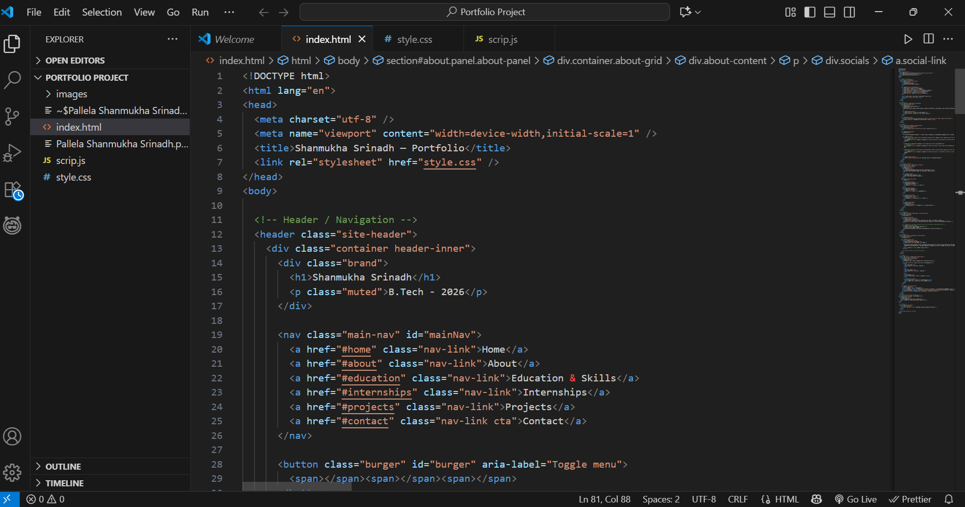
Result

Slide 8
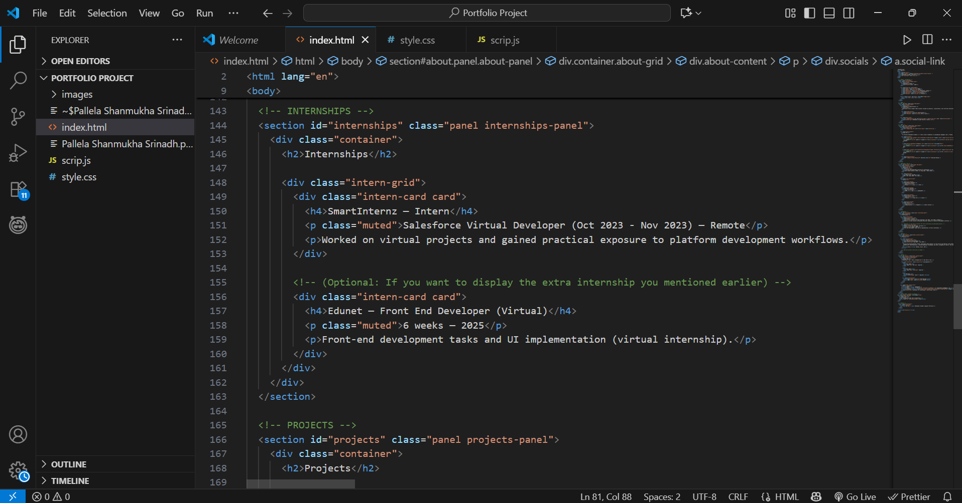

Slide 9
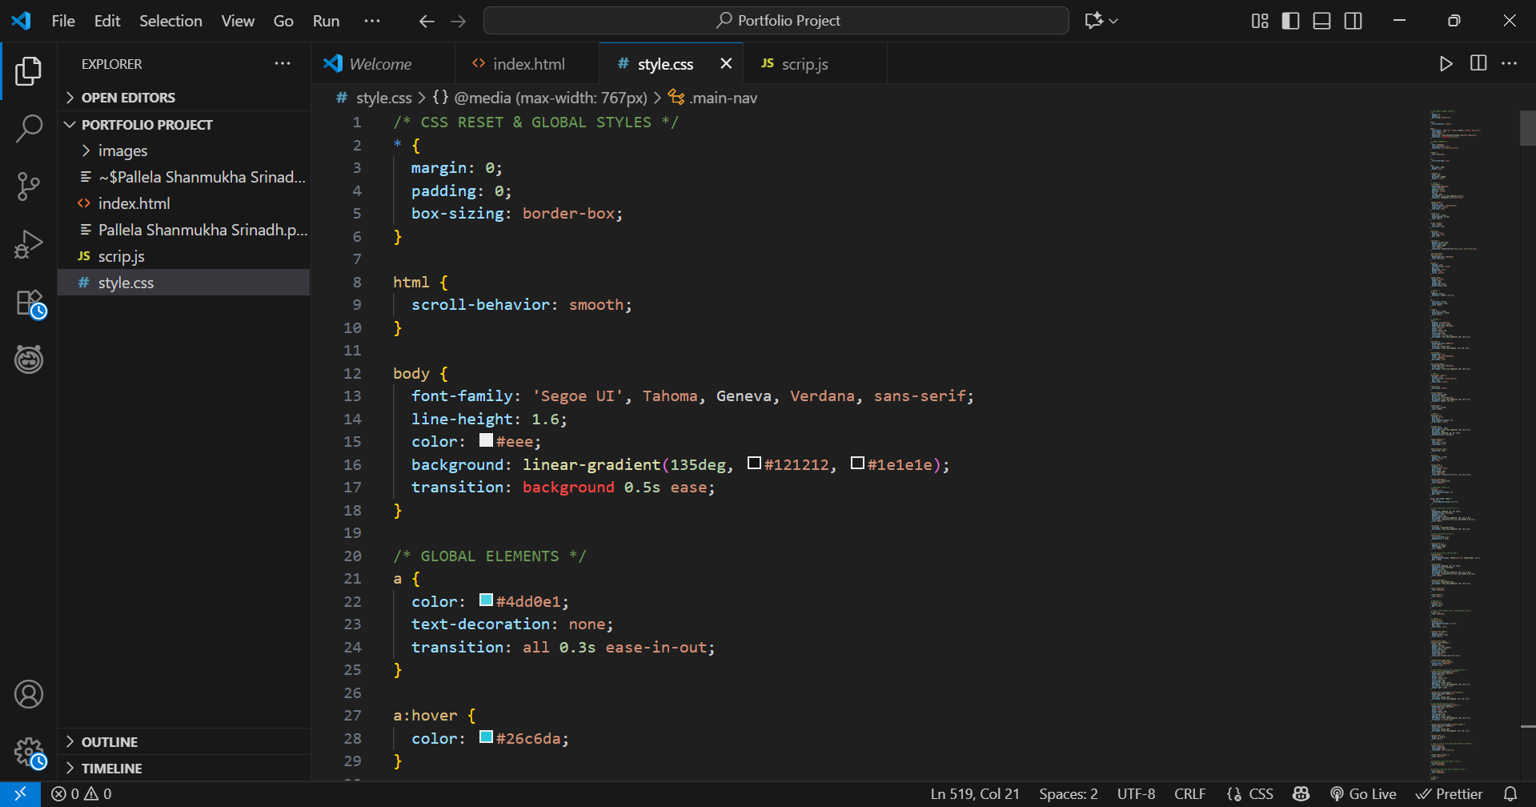

Slide 10
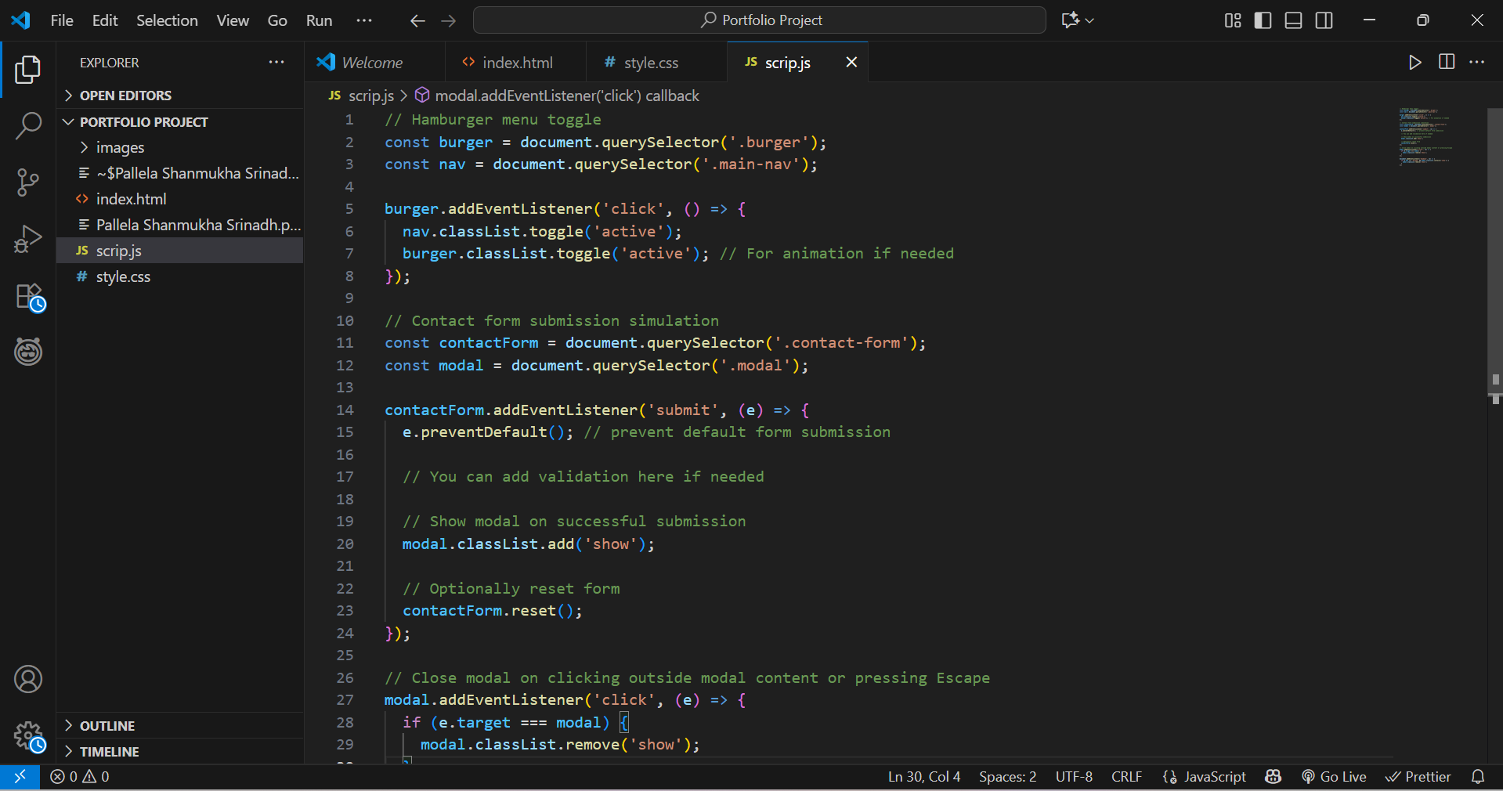

Slide 11
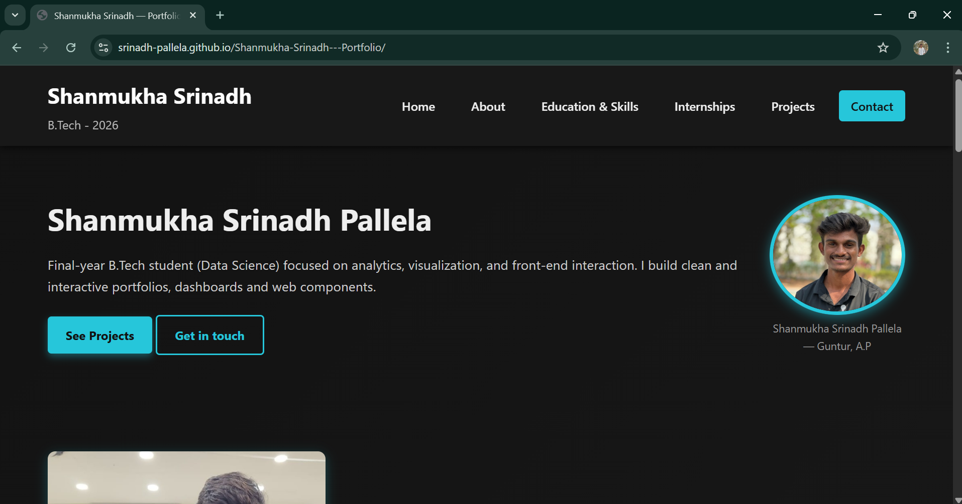

Slide 12
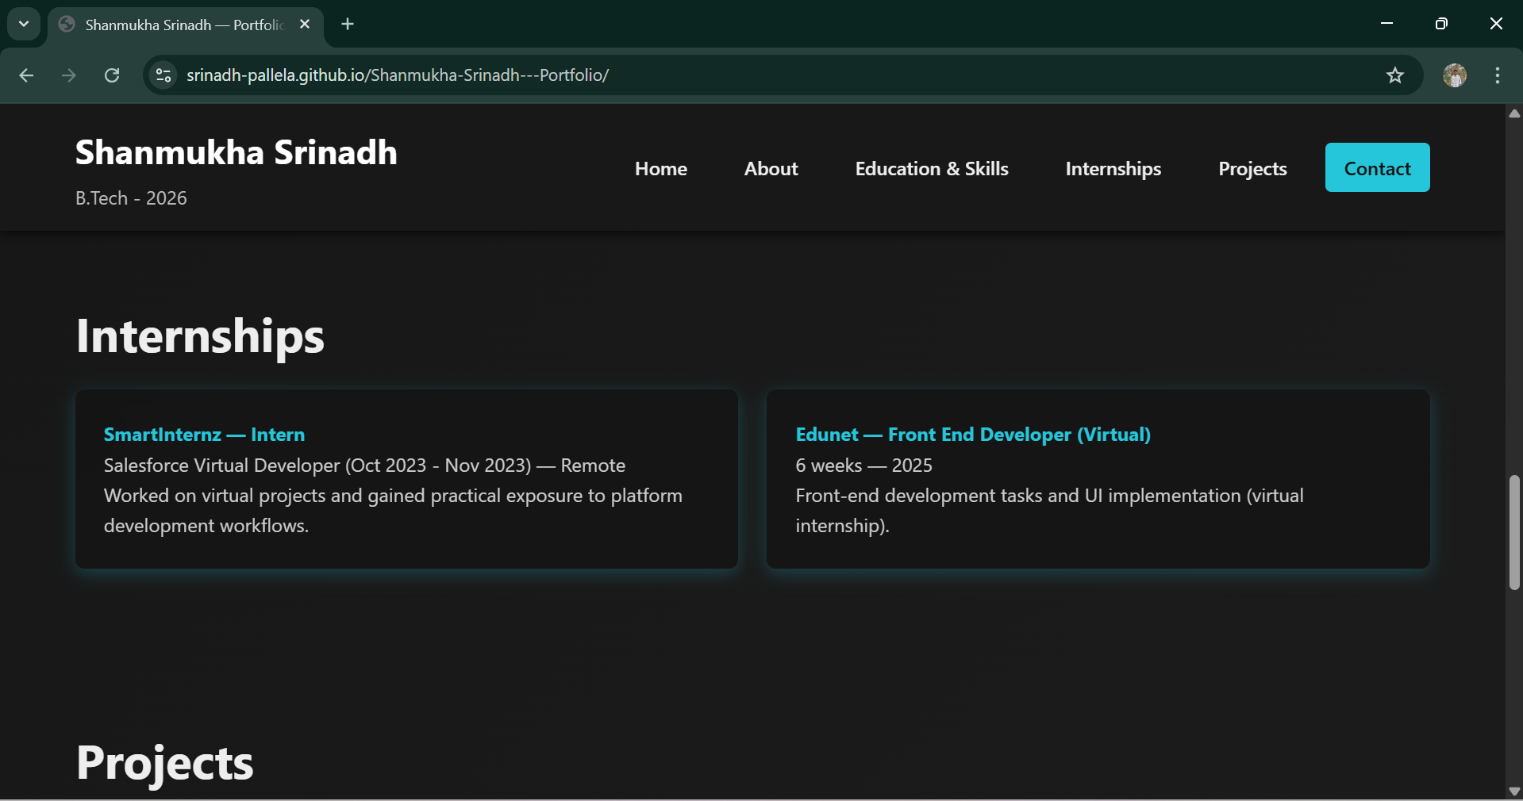

Slide 13
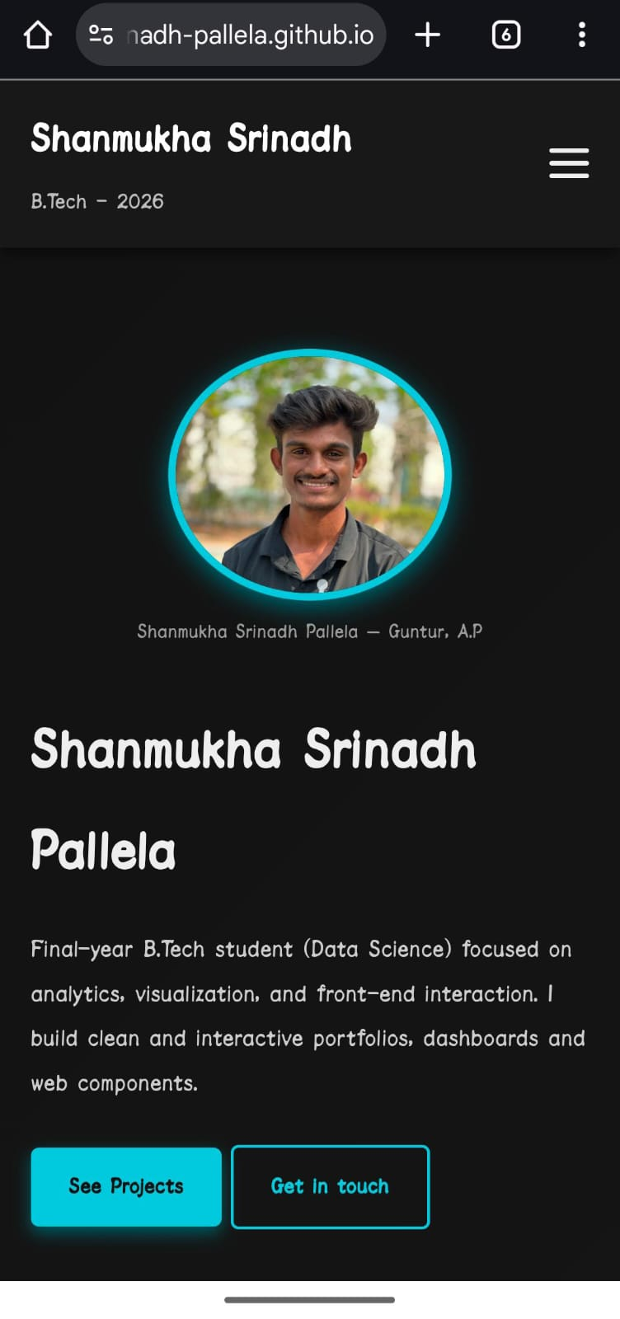

Slide 14
Github and deployment links
Github link : https://github.com/Srinadh-Pallela/Shanmukha-Srinadh---Portfolio.git
Deployment Link : https://srinadh-pallela.github.io/Shanmukha-Srinadh---Portfolio/

Slide 15
Conclusion
The project demonstrates the creation of a dynamic, interactive portfolio website.
Built using HTML, CSS, and JavaScript to ensure a responsive and visually appealing design.
User-friendly interface with smooth navigation and interactive elements (animations, smooth scrolling).
Deployed on GitHub Pages for easy access and real-time updates.
Successfully showcases the developer’s skills, projects, and contact information in an engaging way.
Enhances user experience through clean design and responsive layout.

Slide 16
Future scope
Add a blog section to share insights and tutorials.
Integrate with GitHub to show real-time project updates.
Implement a dark mode/light mode toggle for user customization.
Enhance animations and interactivity with advanced libraries like GSAP.
Add a backend to the contact form for email functionality.
Optimize the website for SEO to improve visibility.
Improve page load speed by optimizing images and files.
Add a project filter to sort or search projects by technology or date.
Integrate Google Analytics to track site traffic and user behavior.
Improve accessibility to make the website more inclusive.

Slide 17
References
List and cite relevant sources, research papers, and articles that were instrumental in developing the proposed solution.
https://www.w3schools.com/html/
https://www.youtube.com/watch?v=-G-zic_LS0A&t=140s

Slide 18
THANK YOU

